Slide 1
Introduction to NLP
Dr. k.m. Azharul hasan
Presented By
Md badiuzzaman Sh

Slide 2
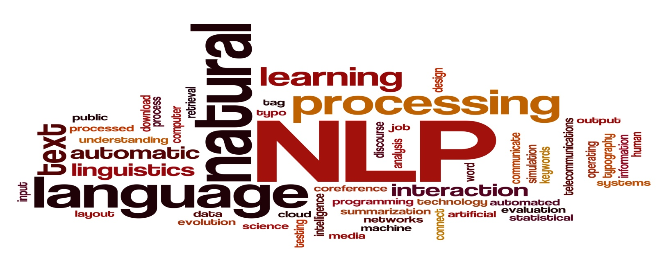
NLP

Slide 3
Natural Language Processing(NLP)
Natural language processing (NLP) is a field of computer science, artificial intelligence and computational linguistics
concerned with the interactions between computers and human natural languages.
Mid-1930s, by G. Artsrouni
an automatic bilingual dictionary using paper tape.
The first attempt to use Bangla in computing was made in the early 1980s with Bangla font development in the Windows environment.

Slide 4
NLP vs Text mining
NLP automates things that humans do well, so that they can be done automatically.
But Text mining that’s hard even for humans.
Text mining /Computational linguistics can discover underlying patterns in large datasets:
things we didn’t know!

Slide 5
Why NLP is difficult
Many hidden variables
Knowledge about the language (ins and outs)
Knowledge about the world
Knowledge about the context of the language.
Knowledge about human communication techniques with the language.
Structure, semantic, tone, scope….
Problem of scale
Many (infinite?) possible words, meanings, context
Problem of sparsity
Very difficult to do statistical analysis, most things (words, concepts) are never seen before
Huge computational cost
Processor speed increased
Long range correlations between the variables

Slide 6
The NLP Community
Institutions
Universities: Most univ. have NLP lab. and faculty
Several “big players” with many faculty
Some of them also have good linguistics, cognitive science, machine learning, AI
Companies:
Old days: AT&T Bell Labs, IBM
Now: Google, Microsoft, IBM, ORACLE, Amazon, Yahoo ,many startups …
Speech processing …
Machine translation …
Many niche markets –
online reviews,
medical transcription,
news summarization,
legal search and discovery …

Slide 7
The NLP Research Community (Cont…)
Conferences
Main annual conferences: ACL, EMNLP, NAACL
Also EACL, IJCNLP, COLING
+ various specialized conferences and workshops
Big events, and growing fast! ACL 2015:
About 1500 attendees
692 full-length papers submitted (173 accepted)
648 short papers submitted (145 accepted)
14 workshops on various topics
Most work in NLP is published as 8-page conference papers with 3 double-blind reviewers.

Slide 8
NLP Research : Standard task
If you want people to work on your problem, make it easy for them to get started and to measure their progress.
Create
Test data, for evaluating the final systems
Development of dataset
An evaluation metric (formula for measuring how well a system does on the dataset)
A program for computing the evaluation metric
Labeled training data and other data resources
A clear set of rules on what data can be used

Slide 9
NLP Tools
A lot of tools have been published to do natural language processing jobs. Mostly for English..
OpenNLP
The Apache OpenNLP library is a machine learning based toolkit for the processing of natural language text. (https://opennlp.apache.org/)
Stanford Parser/ Stanford NLP
Probabilistic natural language parsers, both highly optimized PCFG* and lexicalized dependency parsers, and a lexicalized PCFG parser; Arabic, Enlish, French, Spanish, Chinese, German ; (https://nlp.stanford.edu/software/)
ScalaNLP: Natural Language Processing and machine learning.
Breeze: Linear algebra, numerics, visualization
Nak: Machine Learning
Epic: Natural Language Processing and Structured Prediction
Junto: Label Propagation
Puck: Super-fast GPU parser

Slide 10
NLP Tools(Cont…)
MALLET:( MAchine Learning for LanguagE Toolkit)
A Java-based package for statistical natural language processing, document classification, clustering, topic modeling, information extraction, and other machine learning applications to text. (http://mallet.cs.umass.edu/)
Apache Lucene Core
A library for stop-words removal and stemming (https://lucene.apache.org/)
Stanford Topic Modelling Toolbox:
Modeling tools to perform analysis on datasets that have a substantial textual component. (https://nlp.stanford.edu/software/tmt/tmt-0.4/)
Python & NLTK-Natural Language Toolkit (4 or 5)
NLTK defines an infrastructure that can be used to build NLP programs in Python. It provides basic classes for representing data relevant to natural language processing. (http://www.nltk.org/download)

Slide 11

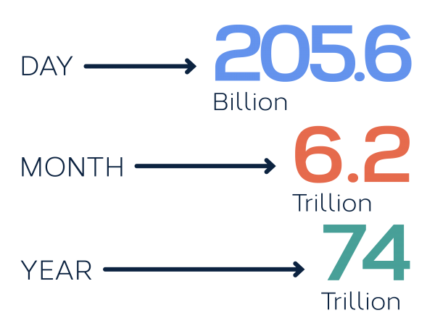


Growth of text data
In 2015, emails sent
Source: www.textrequest.com

Slide 12
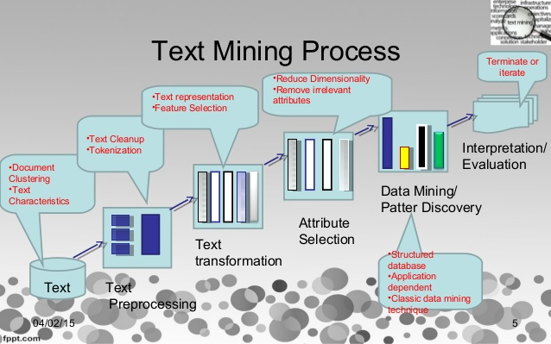
Text mining typical process

Slide 13
Text mining: The theme
Get the right information
To the right people
At the right time
On the right medium
In the right language
With the right level of detail

Slide 14
Relevant Text Mining Technologies
“…right information”
“…right people”
“…right time”
“…right medium”
“…right language”
“…right level of detail”
IR (search engines)
Classification, routing
Real time analysis
Info extraction, speech
Machine translation
Summarization

Slide 15




Language Technology
making good progress
Sentiment analysis
still really hard
mostly solved
Best roast chicken in San Francisco!
Question answering (QA)
The waiter ignored us for 20 minutes.
Spam detection
Coreference resolution
Q. How effective is ibuprofen in reducing fever in patients with acute febrile illness?
✓
Let’s go to Agra!
✗
Carter told Mubarak he shouldn’t run again.
Paraphrase
Buy V1AGRA …
Word sense disambiguation (WSD)
XYZ acquired ABC yesterday
Part-of-speech (POS) tagging
I need new batteries for my mouse.
ABC has been taken over by XYZ
ADJ ADJ NOUN VERB ADV
Parsing
Summarization
Colorless green ideas sleep furiously.
The Dow Jones is up
Economy is good
I can see Alcatraz from the window!
The S&P500 jumped
Named entity recognition (NER)
Machine translation (MT)
Housing prices rose
PERSON ORG LOC
第13届上海国际电影节开幕…
Dialog
Where is Citizen Kane playing in SF?
Einstein met with UN officials in Princeton
The 13th Shanghai International Film Festival…
Information extraction (IE)
Castro Theatre at 7:30. Do you want a ticket?
You’re invited to our dinner party, Friday May 27 at 8:30
Party May 27 add

Slide 16
Information Extraction
Subject: curriculum meeting
To: az@cse.kuet.ac.bd
Dear all,
we’ve now scheduled the curriculum meeting.
It will be in CSE 301. tomorrow from 10:30-11:30.
-Head
Event: Curriculum mtg
Date: Jan-16-2012
Start: 10:30am
End: 11:30am
Where: CSE 301
Create new Calendar entry

Slide 17

Information Extraction & Sentiment Analysis
Attributes:
zoom
affordability
size and weight
flash
ease of use
Size and weight
✓
nice and compact to carry!
since the camera is small and light, I won't need to carry around those heavy, bulky professional cameras either!
the camera feels flimsy, is plastic and very light in weight you have to be very delicate in the handling of this camera
✓
✗

Slide 18
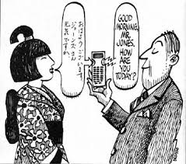
Machine Translation
Fully automatic
Helping human translators
Enter Source Text:
这 不过 是 一 个 时间 的 问题 .
Translation from Stanford’s Phrasal:
This is only a matter of time.

Slide 19

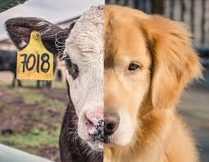
Ambiguity is pervasive
New York Times headline (17 May 2000)
Fed raises interest rates
Fed raises interest rates
Fed raises interest rates 0.5%

Slide 20
Assistive computing
Interfaces for disabled
Many devices involve language issues, e.g.
Text simplification or summarization for users with low literacy (partially sighted, dyslexic, non-native speaker, illiterate, etc.)
Text completion (predictive or retrospective)
Works on basis of probabilities or previous examples

Slide 21
Why else is natural language understanding difficult?
non-standard English
segmentation issues
idioms
Great job @justinbieber! Were SOO PROUD of what youve accomplished! U taught us 2 #neversaynever & you yourself should never give up either♥
dark horse
get cold feet
lose face
throw in the towel
the New York-New Haven Railroad
the New York-New Haven Railroad
neologisms
world knowledge
tricky entity names
unfriend
Retweet
bromance
Mary and Sue are sisters.
Mary and Sue are mothers.
Where is A Bug’s Life playing …
Let It Be was recorded …
… a mutation on the for gene …
But that’s what makes it fun!

Slide 22
Making progress on this problem…
The task is difficult! What tools do we need?
Knowledge about language
Knowledge about the world
A way to combine knowledge sources
How we generally do this:
probabilistic models built from language data
P(“maison” → “house”) high
P(“L’avocat général” → “the general avocado”) low
Luckily, rough text features can often do half the job.

Slide 23
Skills you’ll need
Simple linear algebra (vectors, matrices)
Basic probability theory
Java or Python programming
(if you want to implement)

Slide 24
THANK YOU

